Slide 1



SCHEMA REFINEMENT- NORMALIZATION
MODULE-4

Slide 2

SYLLABUS
Purpose of Normalization or Schema Refinement
Concept of Functional Dependency
Normal Forms based on Functional Dependency
Loss less join and Dependency Preserving Decomposition
1NF, 2NF and 3NF
Concept of Surrogate Key
Boyce - Codd normal form (BCNF)
Multi Valued Dependencies
Fourth normal form(4NF)
Fifth Normal Form (5NF)

Slide 3

SCHEMA REFINEMENT
Redundancy refers to repetition of same data or duplicate copies of same data stored in different locations.
Anomalies refers to the problems occurred after poorly planned and normalized databases where all the data is stored in one table which is sometimes called a flat file database.

Slide 4
SCHEMA REFINEMENT
Problems Caused by Redundancy and Anomalies
Storing the same information redundantly, that is, in more than one place within a database, can lead to several problems:
Redundant Storage: Some information is stored repeatedly.
Update Anomalies: If one copy of such repeated data is updated, an inconsistency is created unless all copies are similarly updated.
Insertion Anomalies: It may not be possible to store some information unless some other information is stored as well.
Deletion Anomalies: It may not be possible to delete some information without losing some other information as well.

Slide 5
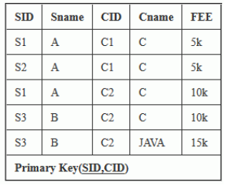
SCHEMA REFINEMENT
Problems Caused by Redundancy and Anomalies

Slide 6
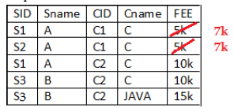
SCHEMA REFINEMENT
Problem in updation / updation anomaly
If there is updation in the fee from 5000 to 7000, then we have to update FEE column in all the rows, else data will become inconsistent.

Slide 7
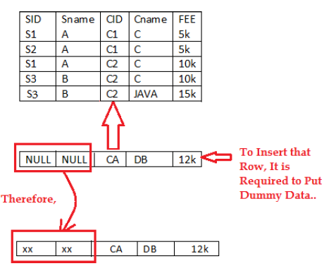
SCHEMA REFINEMENT
Problem in Insertion Anomalies
New course is introduced C4, But no student is there who is having C4 subject.

Slide 8
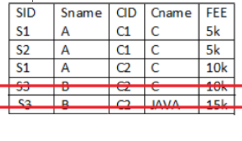
SCHEMA REFINEMENT
Problem in Deletion Anomalies
Deletion of S3 student cause the deletion of course. Because of deletion of some data forced to delete some other useful data.

Slide 9
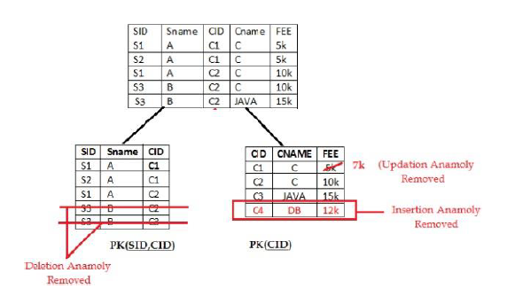
SCHEMA REFINEMENT
Solution

Slide 10
SCHEMA REFINEMENT
Schema Refinement is a process in database design and development where a database schema (its structure, tables, and relationships) is improved to ensure better performance, consistency, and usability.
The goal of schema refinement is to eliminate redundancy, minimize anomalies, and optimize data storage by organizing data logically.
It often involves techniques like normalization and restructuring relationships among tables. This step is essential for maintaining data integrity and ensuring efficient database operations.

Slide 11
SCHEMA REFINEMENT
Normalization: split the tables into small tables which will contain less number of attributes in such a way that table design must not contain any problem of inserting, deleting, updating anomalies and guarantees no redundancy.
Normalization or Schema Refinement is a technique of organizing the data in the database. It is a systematic approach of decomposing tables to eliminate data redundancy and undesirable characteristics like Insertion, Update and Deletion Anomalies.

Slide 12
SCHEMA REFINEMENT
PURPOSE OF NORMALIZATION
Minimize the redundancy in data.
Remove insert, update, and delete anomalies during the database activities.
Reduce the need to organize the data when it is modified or enhanced.
Normalization reduces a complex user view to a set of small and sub groups of fields or relations. This process helps to design a logical data model known as conceptual data model.

Slide 13
FUNCTIONAL DEPENDENCY
Functional Dependency in DBMS is an important concept that describes the relationship between attributes (columns) in a table.
A functional dependency (FD) exists between two attributes when the value of one attribute, the determinant determines the value of another attribute, the dependent.
If attribute A functionally determines attribute B, we write this as the A→B.

Slide 14
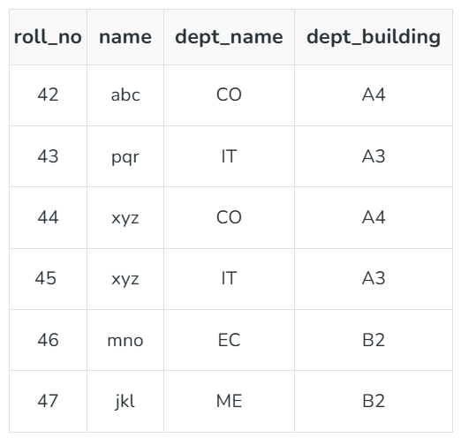
FUNCTIONAL DEPENDENCY
EXAMPLE

Slide 15
FUNCTIONAL DEPENDENCY
roll_no → { name, dept_name, dept_building }
Here, roll_no can determine values of fields name, dept_name and dept_building, hence a valid Functional dependency.
roll_no → dept_name
Since, roll_no can determine whole set of {name, dept_name, dept_building}, it can determine its subset dept_name also.

Slide 16
FUNCTIONAL DEPENDENCY
dept_name → dept_building
Dept_name can identify the dept_building accurately, since departments with different dept_name will also have a different dept_building.
More valid functional dependencies:
roll_no → name,
{roll_no, name} ⇢ {dept_name, dept_building}, etc.

Slide 17
FUNCTIONAL DEPENDENCY
Invalid Functional Dependencies
name → dept_name
Students with the same name can have different dept_name, hence this is not a valid functional dependency.
dept_building → dept_name
There can be multiple departments in the same building. Example, in the above table departments ME and EC are in the same building B2, hence dept_building → dept_name is an invalid functional dependency.

Slide 18
FUNCTIONAL DEPENDENCY
Types of Functional Dependencies in DBMS
Trivial functional dependency
Non-Trivial functional dependency
Multivalued functional dependency
Transitive functional dependency

Slide 19
FUNCTIONAL DEPENDENCY
TRIVIAL FUNCTIONAL DEPENDENCY
In Trivial Functional Dependency, a dependent is always a subset of the determinant. i.e. If X → Y and Y is the subset of X, then it is called trivial functional dependency.
Symbolically: A→B is trivial functional dependency if B is a subset of A.
The following dependencies are also trivial: A→A & B→B

Slide 20
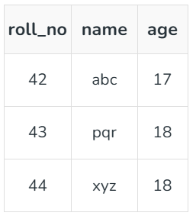
FUNCTIONAL DEPENDENCY
TRIVIAL FUNCTIONAL DEPENDENCY
Example 1 :
ABC -> AB
ABC -> A
ABC -> ABC
Here, {roll_no, name} → name is a trivial functional dependency,

Slide 21
FUNCTIONAL DEPENDENCY
NON-TRIVIAL FUNCTIONAL DEPENDENCY
In Non-trivial functional dependency, the dependent is strictly not a subset of the determinant. i.e. If X → Y and Y is not a subset of X, then it is called Non-trivial functional dependency.
Example 1 :
Id -> Name
Name -> DOB

Slide 22
FUNCTIONAL DEPENDENCY
SEMI NON-TRIVIAL FUNCTIONAL DEPENDENCY
A semi non-trivial functional dependency occurs when part of the dependent attribute (right-hand side) is included in the determinant (left-hand side), but not all of it. This is a middle ground between trivial and non-trivial functional dependencies.
X -> Y is called semi non-trivial when X intersect Y is not NULL.

Slide 23

FUNCTIONAL DEPENDENCY
SEMI NON-TRIVIAL FUNCTIONAL DEPENDENCY
{StudentID,CourseID}→CourseID
This is semi non-trivial because
Part of the dependent attribute (Course_ID) is already included in the determinant ({Student_ID, Course_ID}).
However, the dependency is not completely trivial because {StudentID}→CourseID is not implied directly.

Slide 24
FUNCTIONAL DEPENDENCY
MULTI VALUED FUNCTIONAL DEPENDENCY
In Multivalued functional dependency, entities of the dependent set are not dependent on each other. i.e. If a → {b, c} and there exists no functional dependency between b and c, then it is called a multivalued functional dependency.

Slide 25
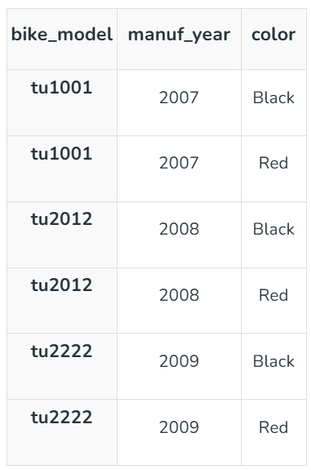
FUNCTIONAL DEPENDENCY
MULTI VALUED FUNCTIONAL DEPENDENCY
In this table:
X: bike_model
Y: color
Z: manuf_year
For each bike model (bike_model):
There is a group of colors (color) and a group of manufacturing years (manuf_year).
The colors do not depend on the manufacturing year, and
the manufacturing year does not depend on the colors. They are independent.
The sets of color and manuf_year are linked only to bike_model.

Slide 26
FUNCTIONAL DEPENDENCY
TRANSITIVE FUNCTIONAL DEPENDENCY
In transitive functional dependency, dependent is indirectly dependent on determinant. i.e. If a → b & b → c, then according to axiom of transitivity, a → c. This is a transitive functional dependency.

Slide 27
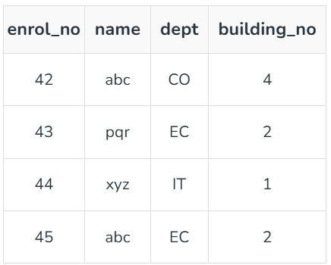
FUNCTIONAL DEPENDENCY
EXAMPLE
Here, enrol_no → dept and dept → building_no.
According to the axiom of transitivity, enrol_no → building_no is a valid functional dependency.

Slide 28
FUNCTIONAL DEPENDENCY
FULLY FUNCTIONAL DEPENDENCY
In full functional dependency an attribute or a set of attributes uniquely determines another attribute or set of attributes.
If a relation R has attributes X, Y, Z with the dependencies X->Y and X->Z which states that those dependencies are fully functional.

Slide 29
FUNCTIONAL DEPENDENCY
PARTIAL FUNCTIONAL DEPENDENCY
In partial functional dependency a non key attribute depends on a part of the composite key, rather than the whole key. If a relation R has attributes X, Y, Z where X and Y are the composite key and Z is non key attribute. Then X->Z is a partial functional dependency in RBDMS.

Slide 30
FUNCTIONAL DEPENDENCY
Armstrong’s Axioms in Functional Dependency
Axioms is a set of inference rules used to infer all the functional dependencies on a relational database.
The term Armstrong Axioms refers to the sound and complete set of inference rules or axioms, introduced by William W. Armstrong, that is used to test the logical implication of functional dependencies.

Slide 31
FUNCTIONAL DEPENDENCY
Axioms
Axiom of Reflexivity: If A is a set of attributes and B is a subset of A, then A holds B. If B⊆A then A→B. This property is trivial property.
Axiom of Augmentation: If A→B holds and Y is the attribute set, then AY→BY also holds. That is adding attributes to dependencies, does not change the basic dependencies. If A→B, then AC→BC for any C.
Axiom of Transitivity: Same as the transitive rule in algebra, if A→B holds and B→C holds, then A→C also holds. A→B is called A functionally determines B. If X→Y and Y→Z, then X→Z.

Slide 32

FUNCTIONAL DEPENDENCY
Additioanl Rules
Armstrong's Axioms are sound in that they generate only FDs in
when applied to a set F of FDs. They are complete in that repeated application of these rules will generate all FDs in the closure
It is convenient to use some additional rules while reasoning about

Slide 33
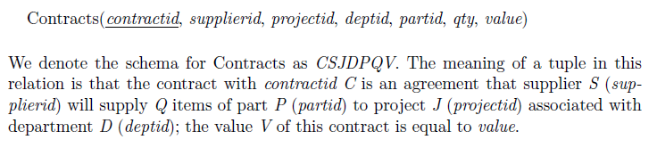
FUNCTIONAL DEPENDENCY
Example

Slide 34
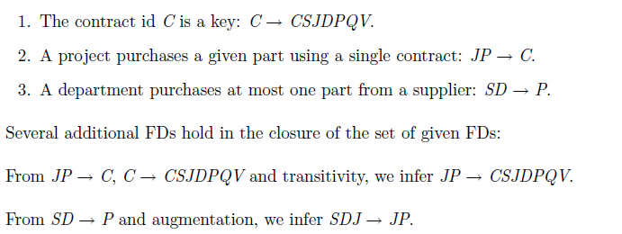
FUNCTIONAL DEPENDENCY
Example

Slide 35
NORMAL FORMS
Given a relation schema, we need to decide whether it is a good design or whether we need to decompose it into smaller relations.
Such a decision must be guided by an understanding of what problems, if any, arise from the current schema. To provide such guidance, several normal forms have been proposed.
If a relation schema is in one of these normal forms, we know that certain kinds of problems cannot arise.

Slide 36
NORMAL FORMS
Redundancy in relation may cause insertion, deletion and update anomalies.
Normalization is a systematic approach to organize data in a database to eliminate redundancy, avoid anomalies and ensure data consistency.
The process involves breaking down large tables into smaller, well-structured ones and defining relationships between them.
This not only reduces the chances of storing duplicate data but also improves the overall efficiency of the database.

Slide 37
NORMAL FORMS
The normal forms based on FDs are
First Normal Form (1NF)
Second Normal Form (2NF)
Third Normal Form (3NF)
Boyce-Codd normal form (BCNF)
Fourth Normal Form (4NF)
Fifth Normal Form (5NF)
These forms have increasingly restrictive requirements:
Every relation in BCNF is also in 3NF, every relation in 3NF is also in 2NF, and every relation in 2NF is in 1NF. A relation in BCNF is considered fully normalized.

Slide 38
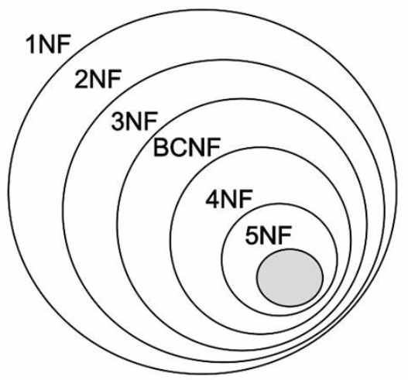
NORMAL FORMS

Slide 39
NORMAL FORMS
These forms have increasingly restrictive requirements:
Every relation in BCNF is also in 3NF,
Every relation in 3NF is also in 2NF, and
Every relation in 2NF is in 1NF.
A relation in BCNF is considered fully normalized.

Slide 40
NORMAL FORMS
First Normal Form (1NF)
This is the most basic level of normalization.
In 1NF, each table cell should contain only a single value, and each column should have a unique name.
The first normal form helps to eliminate duplicate data and simplify queries.

Slide 41
NORMAL FORMS
Second Normal Form (2NF)
2NF eliminates redundant data by requiring that each non-key attribute be dependent on the primary key.
This means that each column should be directly related to the primary key, and not to other columns.

Slide 42
NORMAL FORMS
Third Normal Form (3NF)
3NF builds on 2NF by requiring that all non-key attributes are independent of each other.
This means that each column should be directly related to the primary key, and not to any other columns in the same table.

Slide 43
NORMAL FORMS
Boyce-Codd Normal Form (BCNF)
BCNF is a stricter form of 3NF that ensures that each determinant in a table is a candidate key.
In other words, BCNF ensures that each non-key attribute is dependent only on the candidate key.

Slide 44
NORMAL FORMS
Fourth Normal Form (4NF)
4NF is a further refinement of BCNF that ensures that a table does not contain any multi-valued dependencies.
Fifth Normal Form (5NF)
5NF is the highest level of normalization and involves decomposing a table into smaller tables to remove data redundancy and improve data integrity.

Slide 45
DECOMPOSITIONS
If a relation schema is not in one of these normal forms, the FDs that cause a violation can give us insight into the potential problems.
The main technique for addressing such redundancy-related problems is decomposing a relation schema into relation schemas with fewer attributes.

Slide 46
DECOMPOSITIONS
A decomposition of a relation schema R consists of replacing the relation schema by two (or more) relation schemas that each contain a subset of the attributes of R and together include all attributes in R.
Intuitively, we want to store the information in any given instance of R by storing projections of the instance.

Slide 47

DECOMPOSITIONS
LOSSLESS-JOIN DECOMPOSITION
Let R be a relation schema and let F be a set of FDs over R.
A decomposition of R into two schemas with attribute sets X and Y is said to be a lossless-join decomposition with respect to F if for every instance r of R that satisfies the dependencies in F,
.

Slide 48
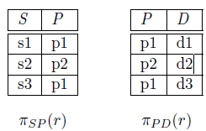
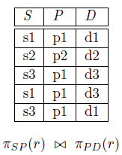
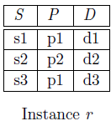
DECOMPOSITIONS

Slide 49
DECOMPOSITIONS
LOSSLESS-JOIN DECOMPOSITION
In particular, suppose that the tuples in r denote relationships. We can no longer tell that the relationships
(s1; p1; d3) and (s3; p1; d1) do not hold.

Slide 50

DECOMPOSITIONS
LOSSLESS-JOIN DECOMPOSITION
In other words, the attributes common to R1 and R2 must contain a key for either R1 or R2.
If a relation is decomposed into two relations, this test is a necessary and sufficient condition for the decomposition to be lossless-join.

Slide 51
DECOMPOSITIONS
LOSSLESS-JOIN DECOMPOSITION
To check for lossless join decomposition the following conditions must hold:
The Union of Attributes of R1 and R2 must be equal to the attribute of R. Each attribute of R must be either in R1 or in R2. Att(R1) U Att(R2) = Att(R)
2. The intersection of Attributes of R1 and R2 must not be NULL.
Att(R1) ∩ Att(R2) ≠ Φ
3. The common attribute must be a key for at least one relation (R1 or R2)
Att(R1) ∩ Att(R2) -> Att(R1) or Att(R1) ∩ Att(R2) -> Att(R2)

Slide 52
DECOMPOSITIONS
DEPENDENCY PRESERVING DECOMPOSITION
The second property of lossless decomposition is dependency preservation which says that after decomposing a relation R into R1 and R2, all dependencies of the original relation R must be present either in R1 or R2 or they must be derivable using the combination of functional dependencies present in R1 and R2.

Slide 53
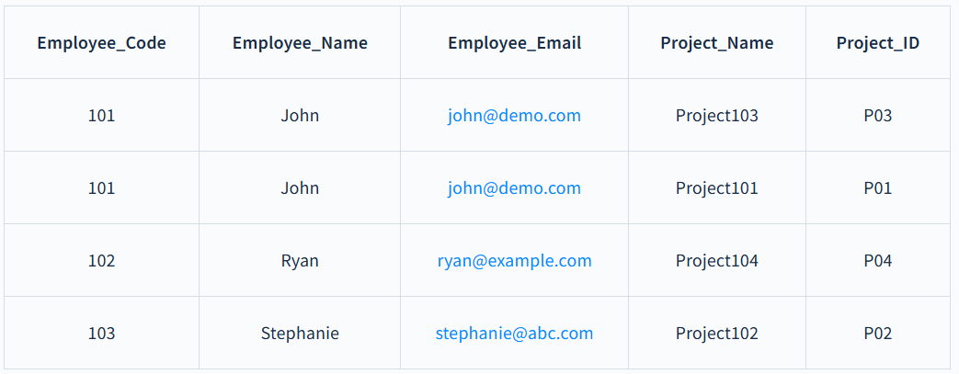
DECOMPOSITIONS
DEPENDENCY PRESERVING DECOMPOSITION

Slide 54
DECOMPOSITIONS
DEPENDENCY PRESERVING DECOMPOSITION
In this relation we have the following FDs:
Employee_Code -> {Employee_Name, Employee_Email}
Project_ID - > Project_Name
Now, after decomposing the relation into EmployeeProject and ProjectDetail

Slide 55
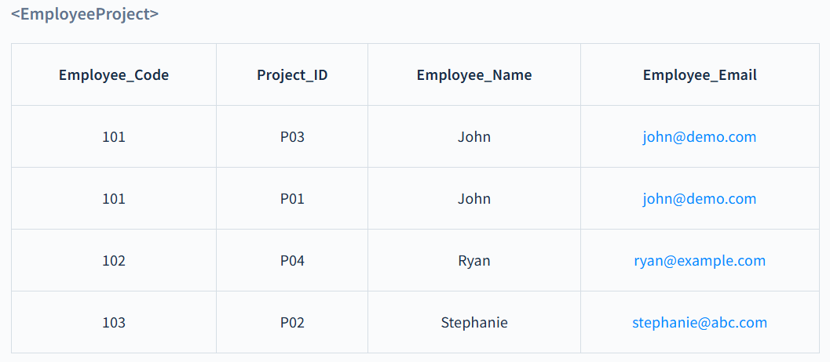
DECOMPOSITIONS
DEPENDENCY PRESERVING DECOMPOSITION
Employee_Code -> {Employee_Name, Employee_Email}

Slide 56
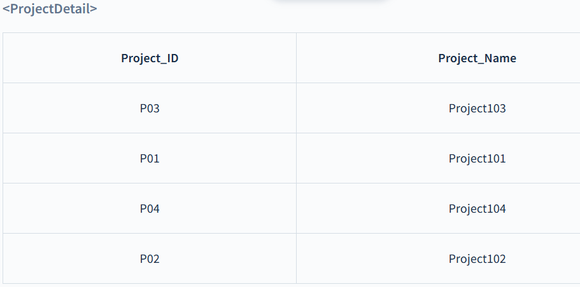
DECOMPOSITIONS
DEPENDENCY PRESERVING DECOMPOSITION
Project_ID - > Project_Name

Slide 57
FIRST NORMAL FORM (1NF)
Ensures that the database table is organized such that each column contains atomic (indivisible) values, and each record is unique.
This eliminates repeating groups, thereby structuring data into tables and columns.

Slide 58
FIRST NORMAL FORM (1NF)
A table is in 1 NF if
There are only Single Valued Attributes.
Attribute Domain does not change.
There is a unique name for every Attribute/Column.
The order in which data is stored does not matter.

Slide 59
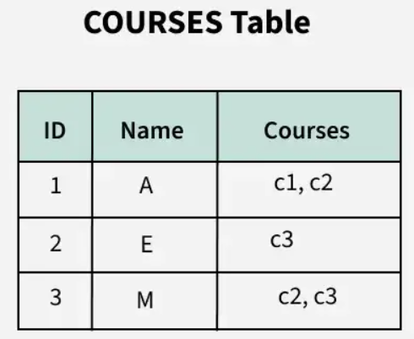
FIRST NORMAL FORM (1NF)

Slide 60
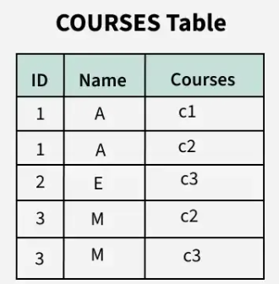
FIRST NORMAL FORM (1NF)

Slide 61
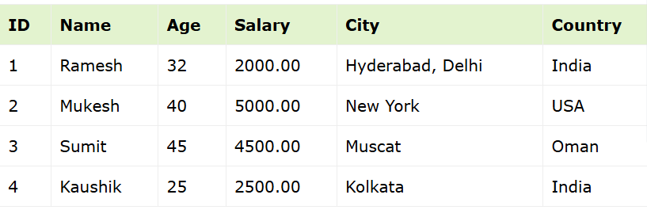
FIRST NORMAL FORM (1NF)

Slide 62
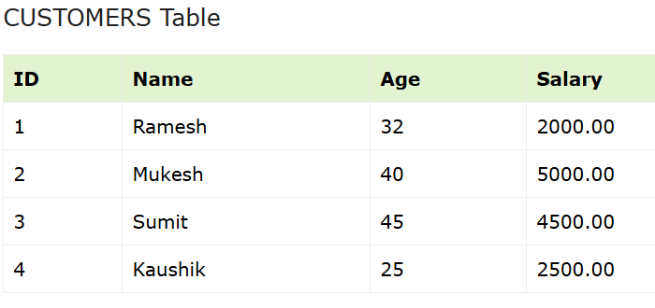
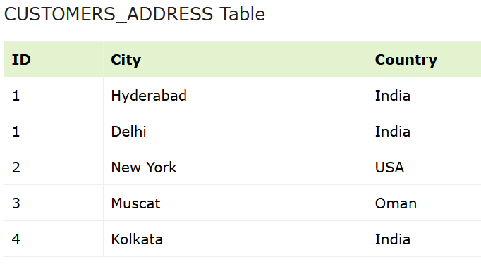
FIRST NORMAL FORM (1NF)

Slide 63
SECOND NORMAL FORM (2NF)
A table is in 2 NF if
For a table to be in 2NF, it must first meet the requirements of First Normal Form (1NF), meaning all columns should contain single, indivisible values without any repeating groups. Additionally, the table should not have partial dependencies.
Rule 1- Be in 1NF
Rule 2- Single Column Primary Key that is not functionally dependent on any subset of candidate key relation

Slide 64

SECOND NORMAL FORM (2NF)

Slide 65
SECOND NORMAL FORM (2NF)
The candidate key for this table is {STUD_NO, COURSE_NO} because the combination of these two columns uniquely identifies each row in the table.
COURSE_FEE is a non-prime attribute because it is not part of the candidate key {STUD_NO, COURSE_NO}.
But, COURSE_NO -> COURSE_FEE, i.e., COURSE_FEE is dependent on COURSE_NO, which is a proper subset of the candidate key.
Therefore, Non-prime attribute COURSE_FEE is dependent on a proper subset of the candidate key, which is a partial dependency and so this relation is not in 2NF.

Slide 66


SECOND NORMAL FORM (2NF)

Slide 67
SECOND NORMAL FORM (2NF)
Now, each table is in 2NF:
The Course Table ensures that COURSE_FEE depends only on COURSE_NO.
The Student-Course Table ensures there are no partial dependencies because it only relates students to courses.

Slide 68
THIRD NORMAL FORM (3NF)
A relation that is in First and Second Normal Form and in which no non-primary-key attribute is transitively dependent on the primary key, then it is in Third Normal Form (3NF).
Rule 1- Be in 2NF
Rule 2- Has no transitive functional dependencies

Slide 69
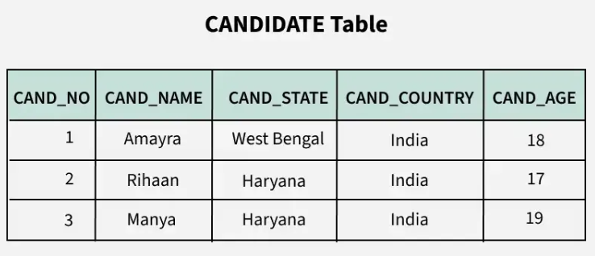
THIRD NORMAL FORM (3NF)

Slide 70
THIRD NORMAL FORM (3NF)
Functional dependency Set:
{CAND_NO -> CAND_NAME,
CAND_NO ->CAND_STATE,
CAND_STATE -> CAND_COUNTRY,
CAND_NO -> CAND_AGE}
So, Candidate key here would be: {CAND_NO}

Slide 71
THIRD NORMAL FORM (3NF)
For the relation given here in the table, CAND_NO -> CAND_STATE and CAND_STATE -> CAND_COUNTRY are actually true. Thus, CAND_COUNTRY depends transitively on CAND_NO. This transitive relation violates the rules of being in the 3NF.
So, if we want to convert it into the third normal form, then we have to decompose the relation CANDIDATE (CAND_NO, CAND_NAME, CAND_STATE, CAND_COUNTRY, CAND_AGE) as:
CANDIDATE (CAND_NO, CAND_NAME, CAND_STATE, CAND_AGE) STATE_COUNTRY (STATE, COUNTRY).

Slide 72
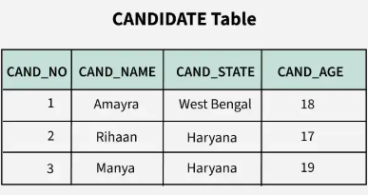
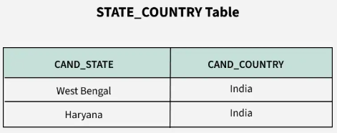
THIRD NORMAL FORM (3NF)

Slide 73
SURROGATE KEY
Natural Key: A column, or group of columns, that is generated from the table’s data is known as a natural key.
Surrogate key: A column that is not generated from the data in the database is known as a surrogate key. Rather, the DBMS generates a unique identifier for you. In database tables, surrogate keys are frequently utilized as primary keys

Slide 74
SURROGATE KEY
Features of the Surrogate Key
It is automatically generated by the system.
It holds an anonymous integer.
It contains a unique value for all records of the table.
The value can never be modified by the user or application.
The surrogate key is called the factless key as it is added just for our ease of identification of unique values and contains no relevant fact(or information) that is useful for the table.

Slide 75
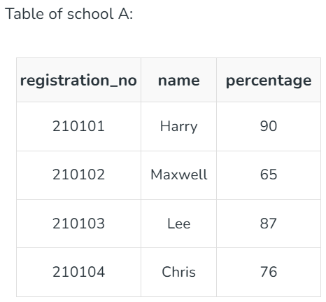
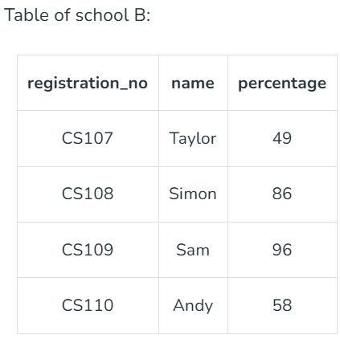
SURROGATE KEY

Slide 76
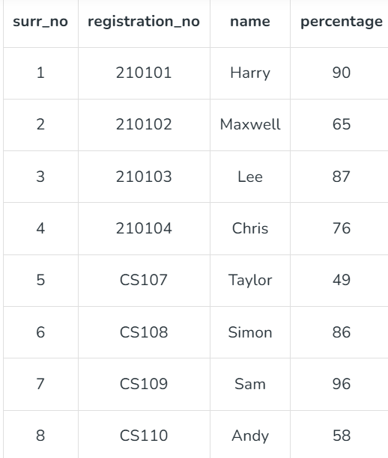
SURROGATE KEY

Slide 77
SURROGATE KEY
Examples of Surrogate Key
System date & time stamp
Random alphanumeric string

Slide 78
BOYCE-CODD NORMAL FORM (BCNF)
Boyce-Codd Normal Form (BCNF) is a stricter version of Third Normal Form (3NF) that ensures a more simplified and efficient database design.
It enforces that every non-trivial functional dependency must have a super key on its left-hand side.
Rule 1: The table should be in the 3rd Normal Form.
Rule 2: X should be a super-key for every functional dependency (FD) X−>Y in a given relation.

Slide 79
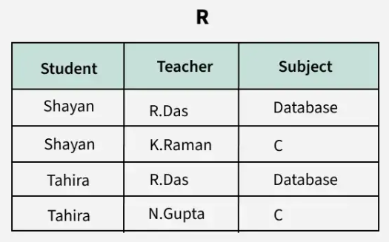
BOYCE-CODD NORMAL FORM (BCNF)
Example

Slide 80
BOYCE-CODD NORMAL FORM (BCNF)
Example

Slide 81
BOYCE-CODD NORMAL FORM (BCNF)
Candidate keys are (student, teacher) and (student, subject).
The above relation is in 3NF (since there is no transitive dependency).
A relation R is in BCNF if for every non-trivial FD X->Y, X must be a key.
The above relation is not in BCNF, because in the FD (teacher->subject), teacher is not a key. This relation suffers with anomalies.
For example, if we delete the student Tahira , we will also lose the information that N.Gupta teaches C. This issue occurs because the teacher is a determinant but not a candidate key.

Slide 82
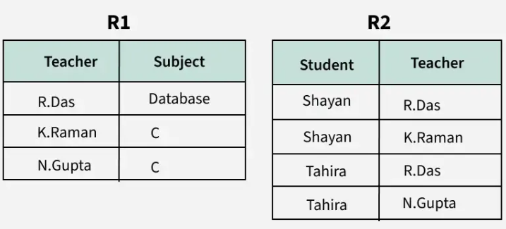
BOYCE-CODD NORMAL FORM (BCNF)
R is divided into two relations R1(Teacher, Subject) and R2(Student, Teacher).

Slide 83
MUTLI VALUED DEPENDENCIES
A multivalued dependency (MVD) occurs when two attributes in a table are independent of each other but both depend on a third attribute.
This concept is crucial for database normalization and maintaining data integrity.
An MVD involves at least three attributes: one attribute that determines the other two, which are independent of each other.
In a database, a multivalued dependency is represented as A ->-> B, meaning that for a single value of attribute A, multiple values of attribute B exist.

Slide 84
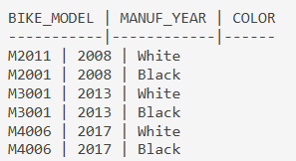
MUTLI VALUED DEPENDENCIES
For instance, consider a bike manufacturer that produces two colors (white and black) of each model every year:
In this table, COLOR and MANUF_YEAR are dependent on BIKE_MODEL but are independent of each other. Thus, we can say that BIKE_MODEL multi-determines MANUF_YEAR and COLOR.

Slide 85
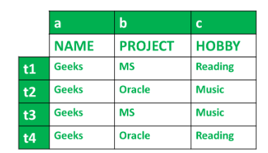
MUTLI VALUED DEPENDENCIES
It is read as a is multi-valued dependent on b. Suppose a person named Geeks is working on 2 projects Microsoft and Oracle and has 2 hobbies namely Reading and Music. This can be expressed in a tabular format in the following way.

Slide 86
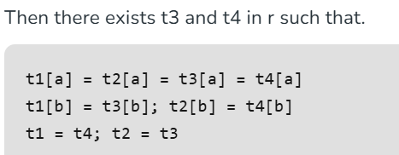

MUTLI VALUED DEPENDENCIES
Conditions for MVD
Any attribute say a multiple define another attribute b; if any legal relation r(R), for all pairs of tuples t1 and t2 in r, such that,

Slide 87
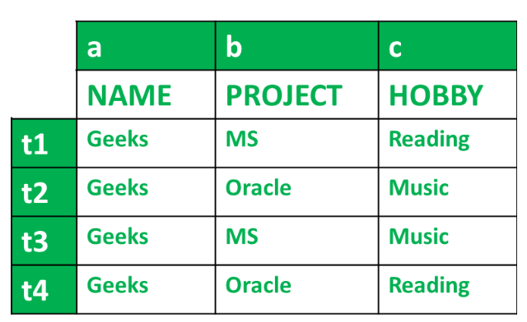
MUTLI VALUED DEPENDENCIES

Slide 88
MUTLI VALUED DEPENDENCIES
All conditions are satisfied, therefore, a --> --> b
According to table we have got,
name --> --> project
And for, a --> --> C
We get,
name --> --> hobby
Hence, we know that MVD exists in the above table and it can be stated by,
name --> --> project
name --> --> hobby

Slide 89
FOURTH NORMAL FORM
Fourth Normal Form comes into picture when Multi-valued Dependency occur in any relation.
To make any table satisfy the fourth normal form, we have to remove Multi-valued Dependency.
Rules for 4th Normal Form
Table should be in the Boyce-Codd Normal Form.
The table should not have any Multi-valued Dependency.

Slide 90
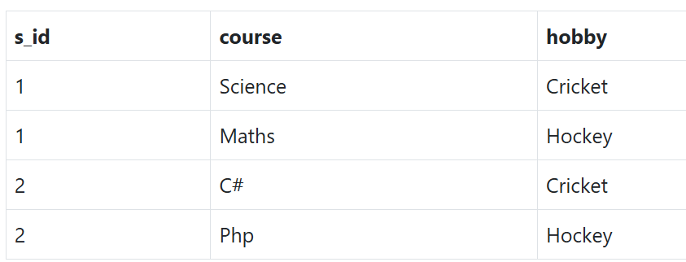
FOURTH NORMAL FORM

Slide 91
FOURTH NORMAL FORM
As you can see in the table above, student with s_id 1 has opted for two courses, Science and Maths, and has two hobbies, Cricket and Hockey.
Well the two records for student with s_id 1, will give rise to two more records, as shown below, because for one student, two hobbies exists, hence along with both the courses, these hobbies should be specified.

Slide 92
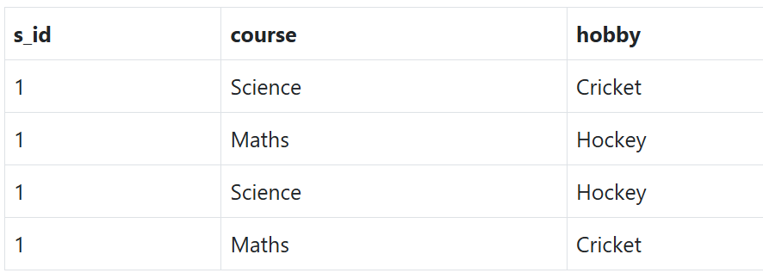
FOURTH NORMAL FORM

Slide 93
FOURTH NORMAL FORM
And, in the table above, there is no relationship between the columns course and hobby. They are independent of each other.
So there is multi-value dependency, which leads to un-necessary repetition of data and other anomalies as well.
To make the above relation satisfy the 4th normal form, we can decompose the table into 2 tables.

Slide 94
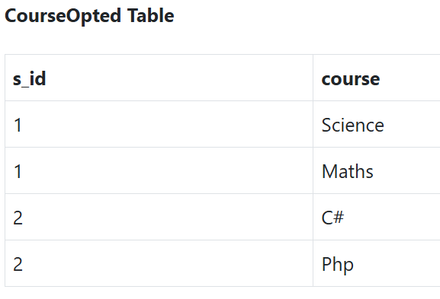
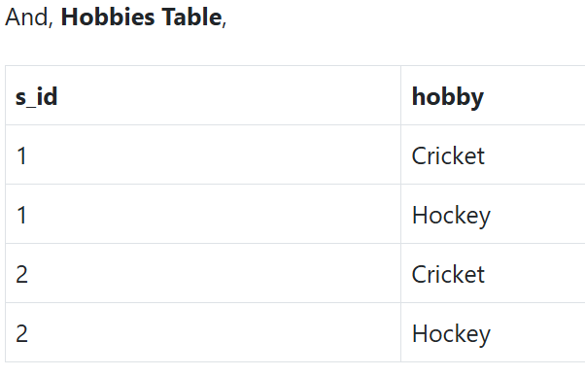
FOURTH NORMAL FORM

Slide 95
FIFTH NORMAL FORM
The Fifth Normal Form (5NF) is also known as the Project-Join Normal Form (PJNF).
5NF gets satisfied when the table is broken down into as many parts as possible to avoid data redundancy.
RULES
1)Relation should be already in 4NF 2) It cannot be further non-loss decomposed (Join-Dependency should not be present)

Slide 96
FIFTH NORMAL FORM
Non-Loss Decomposition
When the table does not contain any join dependency then it is called a lossless /non-loss decomposition.
When we decompose the given table to remove redundancy in the data and then compose it again to create the original table , we should not lose any data, and the original table should be obtained as a loss should happen after the decomposition of the table.

Slide 97
FIFTH NORMAL FORM
Non-Loss Decomposition
Join dependency for relation R can be stated as

Slide 98
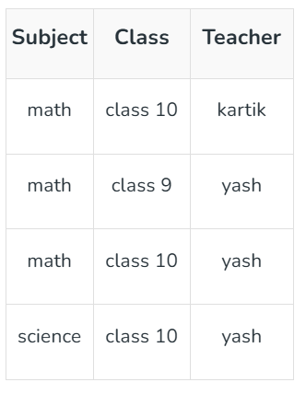
FIFTH NORMAL FORM
EXAMPLE
let's, take of Table R which has 3 columns i.e. subject, class, and teacher where each subject can be taught by many teachers in many classes, and a teacher can teach more than 1 subject.

Slide 99
FIFTH NORMAL FORM
Here the subject of math is taught by both teachers kartik and yash. Also yash can teach math and science. Yash teaches math to both class 9 and class 10.
As there is redundancy in data we will decompose it into two tables R1 and R2 such that R1 will have attribute Subject and Class and R2 will have attribute class and teacher.

Slide 100
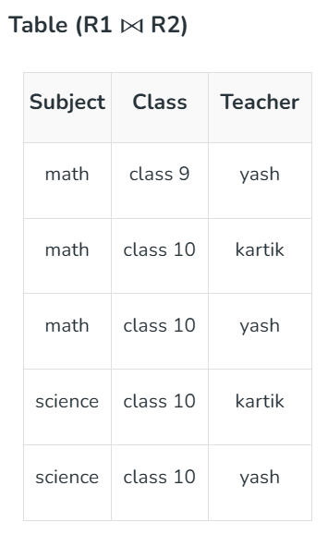
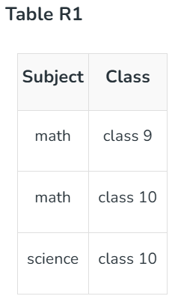
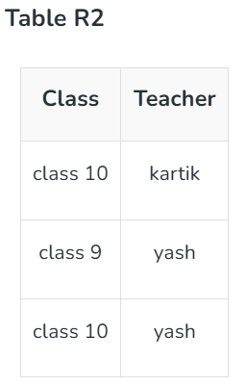
FIFTH NORMAL FORM

Slide 101
FIFTH NORMAL FORM
Here if we notice the newly composed table from R1 and R2 and the original table, an extra tuple is added that did not exist in the original data, This breaks the second rule of 5NF i.e. non-loss decomposition.
Here we will decompose the given table in another relation R3 where it will have 2 columns i.e. subject and teacher.

Slide 102
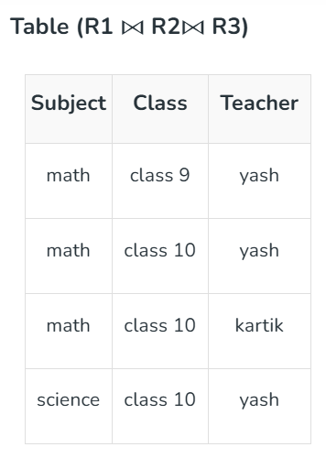
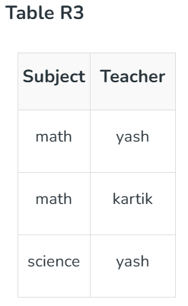
FIFTH NORMAL FORM

Slide 103
END OF MODULE-4

